Slide 1

EXCEPTIONS &
CURSORS
By, Ms. P.olynia V. Kharbuli
Dept. of Computer Sc.
St. Anthony’s College, Shillong

Slide 2
Contents
What are Exceptions?
Classifications of Errors
Built-in Exceptions
%ROWTYPE
User defined exception
What is a Cursor?
Creating Explicit Cursor
The Cursor For Loop
Cursor Worksheet

Slide 3
Exceptions
In PL/SQL, a warning or error condition is called an exception.
When an error occurs, an exception is raised. That is, normal execution stops and control transfers to the exception-handling part of your PL/SQL block or subprogram.
An exception handler is a facility within a program that makes sure that your program deals with errors in a proper way.
Syntax:
EXCEPTION
WHEN <expection_name/no> THEN
-- handle the error
WHEN <expection_name/no> THEN
-- handle the error
WHEN OTHERS THEN
-- handle all other errors
END;

Slide 4
Classification of Errors
Errors
Internally Defined or Built-in
Externally Defined or User-defined
Named
Unnamed
Named
Unnamed

Slide 5
Built-in Exceptions
These errors are pre-defined and are automatically raised by Oracle whenever an error is encountered.
Each error is assigned a “unique number and message”
They can be divided into two types:
Named Errors: These errors can be referred to by names instead of numbers
Unnamed Errors: These errors can be referred to by the unique numbers. They are referred to by the general name “OTHERS”. OTHERS stands for all other exceptions not explicitly named

Slide 6
Common Built-in Exceptions
Exceptions | Description | Oracle Error
no_data_found | When a Select statement returns no rows, this error may be raised. This error usually occurs when you use an implicit cursor and perform a SELECT INTO. | ORA-01403
too_many_rows | This exception is raised when a single row is needed to be returned but has returned multiple rows. | ORA-01422
dup_val_on_index | This exception is raised when you try to insert a record into a table that has a primary key on it, and the record that you are inserting duplicates one that already exists in the table. | ORA-06502
value_error | This error occurs when you attempt to put a value into a variable, but either the value is incompatible or is too big. | ORA-00001

Slide 7
Common Built-in Exceptions
Others:
This exception is used to catch any errors that are not handled by specific error handles. You must always make this error the last one in your program since Oracle will not process any exception handles after this one.
Oracle Error number: Non-specific

Slide 8
%ROWTYPE
The %ROWTYPE attribute provides a record type that represents a row in a table (or view).
The record can store an entire row of data selected from the table or fetched from a cursor or strongly typed cursor variable.
Syntax:
<variable_name> <table_name>%ROWTYPE;
To access each column in the row:
We make use of the dot(.) operator
Syntax:
<variable_name>.<column_name>;

Slide 9
%ROWTYPE
Exercise: Declare a variable to be able to have the same structure as Locations Table.
Declare
L_row locations %ROWTYPE;
Begin
End
In memory
L_row
To store location_id value | To store city value

Slide 10
Built-in Exceptions: Example
DECLARE
e_row employees%ROWTYPE;
BEGIN
SELECT * INTO erow
FROM Employees
WHERE employee_id = 101;
DBMS_OUTPUT.PUT_LINE(‘Employee Name’ ||erow.first_name)
DBMS_OUTPUT.PUT_LINE(‘Salary is = Rs.’ || erow.salary);
EXCEPTION
WHEN no_data_found THEN
DBMS_OUTPUT.PUT_LINE(‘Not a valid employee’);
WHEN others THEN
DBMS_OUTPUT.PUT_LINE(SQLCODE || ‘ ‘ || SQLERRM);
END;
Here SQLCODE shows Oracle’s built-in error number. SQLERRM shows error message

Slide 11
User Defined Exceptions
These are explicitly declared and raised by user.
Raising such exceptions:
PL/SQL blocks and subprograms should raise an exception only when an error makes it undesirable or impossible to finish processing.
You can place RAISE statements for a given exception anywhere within the scope of that exception.
They can be divided into two types:
Named Exceptions
Unnamed Exceptions

Slide 12
User Defined Named Exceptions
Named Exceptions: These exceptions are defined by name and raised explicitly by user.
Declaration Syntax:
error_name EXCEPTION;
To raise the exception:
RAISE error_name;

Slide 13
User Defined Exceptions: example
SET SERVEROUTPUT ON;
DECLARE
out_of_stock EXCEPTION; --user-defined exception
number_on_hand NUMBER(4):=5;
BEGIN
WHILE(number_on_hand != 0) LOOP
number_on_hand:=number_on_hand - 1;
END LOOP;
IF number_on_hand < 1 THEN
RAISE out_of_stock;
END IF;
DBMS_OUTPUT.PUT_LINE(‘Never printed');
EXCEPTION
WHEN out_of_stock THEN --handling the error
DBMS_OUTPUT.PUT_LINE('Number on hand = ' || number_on_hand);
DBMS_OUTPUT.PUT_LINE('Out of stock!');
END;

Slide 14
User Defined Unnamed Exceptions
Unnamed Exceptions: Oracle provides a feature wherein we can RAISE exceptions by our own assigned error number and message without specifying a name to it.
To raise the exception:
RAISE_APPLICATION_ERROR(error_no, error_msg);
error_no: number; error_msg: text
Error numbers for our own defined errors range from -20000 to -20999. The rest of the numbers are reserved by Oracle for its internal exception handling

Slide 15
User Defined Exceptions: example
OUTPUT:
EXCEPTION GENERATED!
-20000
ORA-20000: Out of stock
PL/SQL procedure successfully completed.
SET SERVEROUTPUT ON
DECLARE
number_on_hand NUMBER(4):=5;
BEGIN
WHILE(number_on_hand != 0) LOOP
number_on_hand:=number_on_hand - 1;
END LOOP;
IF number_on_hand < 1 THEN
RAISE_APPLICATION_ERROR(-20000, ‘Out of stock’);
END IF;
DBMS_OUTPUT.PUT_LINE(‘Never printed');
EXCEPTION
WHEN OTHERS THEN
DBMS_OUTPUT.PUT_LINE('EXCEPTION GENERATED!');
DBMS_OUTPUT.PUT_LINE(SQLCODE);
DBMS_OUTPUT.PUT_LINE(SQLERRM);
END;

Slide 16
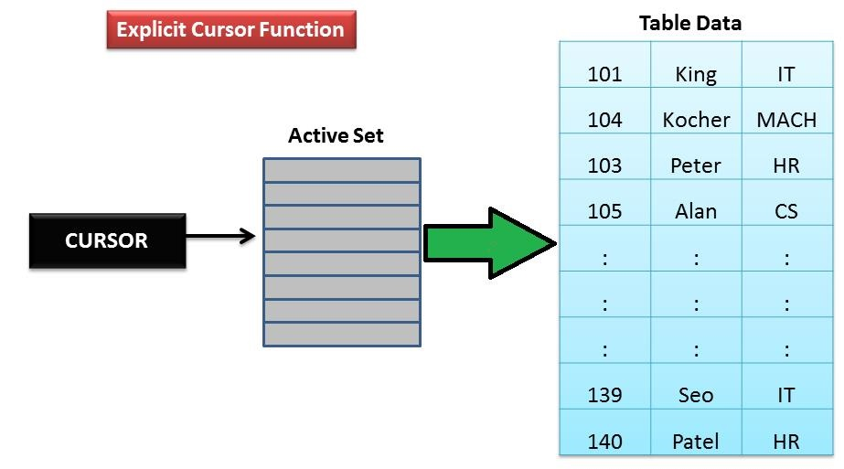
What is a Cursor?
Cursor is the work area which Oracle reserves for internal processing of SQL statements.
The data which is stored there is known as Active Set or Resultset.

Slide 17
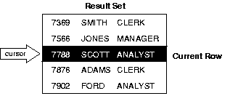
Result Set or Active Set
The set of rows returned by a multi-row query is called the result set. Its size is the number of rows that meet your search criteria.
As the figure shows, an explicit cursor "points" to the current row in the result set. This allows your program to process the rows one at a time.
Figure: Query Processing

Slide 18
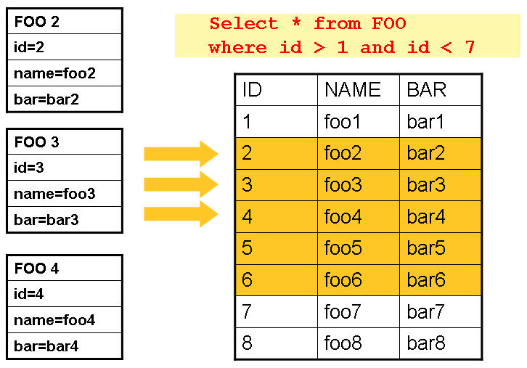
Sample Resultset
ACTIVE DATA SET/RESULTSET
CURSOR

Slide 19
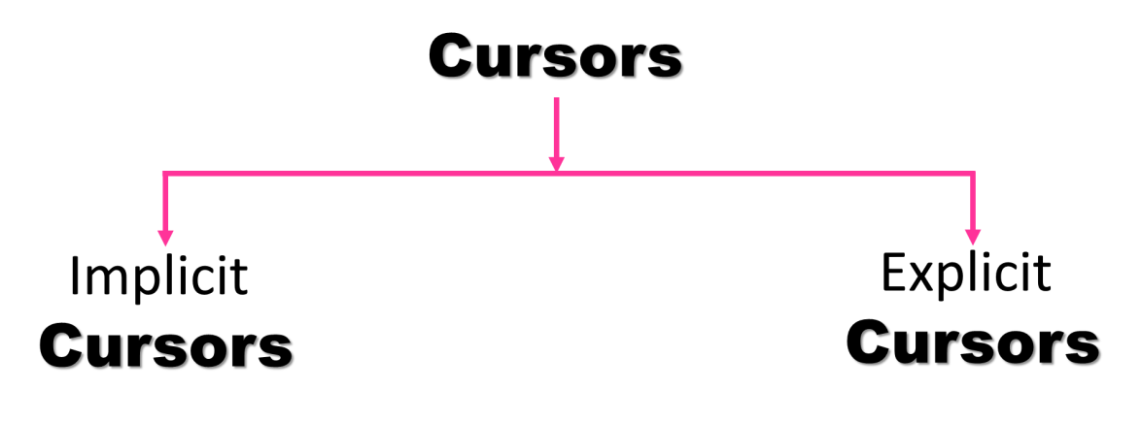
Why is cursor required?
Within a PL/SQL program, a SELECT statement cannot return more than one row at a time.
So in-order to process more than one row, we need to use cursors.
Using cursor, we can process one row at a time starting from the first row up to the last row
Types of cursors: There are two kinds of cursors
Internal Cursor
Managed by Oracle itself
User-defined Cursor
Managed explicitly by programmer

Slide 20
Implicit Cursor
For any SQL statement, Oracle uses implicit cursors for its internal processing, as long as, an explicit cursor does not exists for that SQL statement.
When we execute a DML statement(INSERT/UPDATE/DELETE):
Oracle reserves a private SQL area in memory(which is called cursor)
Populates that area with data i.e. records that will be affected by the query. It rejects records which do not satisfy the condition in the statement.
In a PL/SQL program, an implicit cursor is also assigned for SELECT which retrieves only a single row. It will perform step 1 & 2 and if ORDER BY clause present, arrange the records according to it and finally display records to the user.
Disadvantage: With an implicit cursor, Oracle will handle everything for you, but there is a cost for doing this. The cost is internal within Oracle and will result in a program running slower. The better way is to use an Explicit Cursor.

Slide 21
Implicit Cursor Variables
The most recently opened cursor is called the ‘SQL%’ cursor.
Cursor Attribute | Cursor Variable | Description
%ISOPEN | SQL%ISOPEN | The Oracle Database automatically opens and closes the implicit cursor associated with any select, insert, update or delete statement. As such the SQL%ISOPEN always returns FALSE for implicit cursors.
%FOUND | SQL%FOUND | Returns TRUE if SELECT statement returns one/more than one row, INSERT creates a row, UPDATE, DELETE affect one or more than one rows
%NOTFOUND | SQL%NOTFOUND | Logically opposite of %FOUND
%ROWCOUNT | SQL%ROWCOUNT | Returns the number of rows affected by an insert, update, delete or select statements

Slide 22
Implicit Cursor: Example
Items
ItemNo | Price
1 | 10
2 | 200
3 | 350
SET SERVEROUTPUT ON
BEGIN
UPDATE items
SET price=price+1;
DBMS_OUTPUT.PUT_LINE('***PROGRAM OUTPUT***');
DBMS_OUTPUT.PUT_LINE('Number of affected rows: '|| SQL%ROWCOUNT);
IF (SQL%ISOPEN) THEN
DBMS_OUTPUT.PUT_LINE('Cursor open');
ELSE
DBMS_OUTPUT.PUT_LINE('Cursor closed');
END IF;
IF (SQL%FOUND) THEN
DBMS_OUTPUT.PUT_LINE('Rows found');
ELSE
DBMS_OUTPUT.PUT_LINE('Rows not found');
END IF;
END;
OUTPUT:
***PROGRAM OUTPUT***
Number of affected rows: 3
Cursor closed
Rows found

Slide 23
Drawbacks of Implicit Cursor
Even if the query returns only a single row, we might still decide to use an explicit cursor.
The implicit cursor has the following drawbacks:
It is less efficient than an explicit cursor
It is more vulnerable to data errors
It gives the programmer less programmatic control

Slide 24
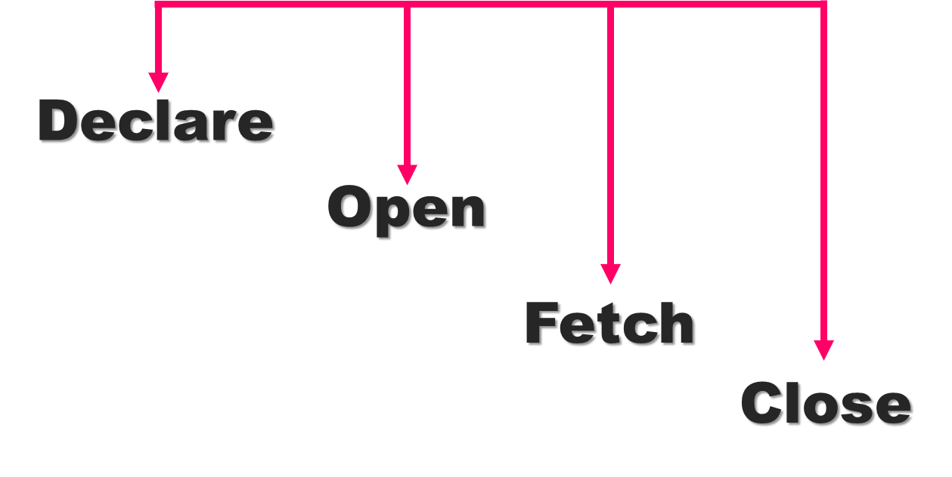
Explicit Cursor
Usage: For SELECT queries that return more than one row, we have to explicitly declare a cursor to process the rows individually.

Slide 25
Steps involved in using Explicit Cursor
Declare a cursor: specifies the SQL statement to be processed
OPEN the cursor:
reserves the memory area
will populate the memory with required records
a pointer is placed before the first record
Fetch one record at a time from Resultset:
It moves the pointer first and then retrieves a single row that the pointer points.
To retrieve all records, this step needs to be in a loop.
Processing logic needs to be applied to one record at a time
Close the cursor: this will free the memory area occupied by Resultset

Slide 26
Explicit Cursor: Syntax
DECLARE
CURSOR cursor_name IS SELECT statement;
BEGIN
OPEN cursor_name;
FETCH cursor_name INTO RowVariables;
CLOSE cursor_name;
END;

Slide 27
Step 3: Creating Explicit Cursor
Once a cursor is declared and opened, the third step is to use the FETCH statement to retrieve the current row from the result set, and advance the cursor to the next row.
Unlike declaring and opening the cursor, the FETCH statement must be executed repeatedly, once for each row in the result set.
Syntax: FETCH cursor_name INTO RowVariables;
We can use a different INTO list on separate fetches with the same cursor.
Each fetch retrieves the next row and assigns values to the target variables, as the following example shows:

Slide 28
Example: Fetching One record
DECLARE
CURSOR c IS SELECT firstname, salary FROM employees;
name employees.firstname %TYPE;
sal employees.salary %TYPE;
BEGIN
OPEN c;
FETCH c INTO name, sal;
DBMS_OUTPUT.PUT_LINE(‘Employee Name : ‘ || name || ‘ Salary : ’ || sal );
CLOSE c;
END;
employees | firstname | salary
 | Susan | 10000
 | John | 15000
 | Rika | 20000
The fetch statement will retrieve
only the first record retrieved within the result set.

Slide 29
Example: Fetching one row at a time
DECLARE
CURSOR c IS SELECT firstname FROM Employee;
name employee.firstname%TYPE;
BEGIN
OPEN c;
FETCH c INTO name; -- this fetches 1st row
DBMS_OUTPUT.PUT_LINE(name);
FETCH c INTO name; -- this fetches 2nd row
DBMS_OUTPUT.PUT_LINE(name);
FETCH c INTO name; -- this fetches 3rd row
DBMS_OUTPUT.PUT_LINE(name);
CLOSE c1;
END;
c | firstname
 | Susan
 | John
 | Rika
We will be successful to display the every information fetched if we know before hand the number of rows that will be fetched

Slide 30
To fetch all rows
employees | fname | salary
 | Susan | 10000
 | John | 15000
 | Rika | 20000
DECLARE
CURSOR c IS SELECT firstname, salary FROM Employee;
name employee.firstname %TYPE;
sal employee.salary %TYPE;
BEGIN
OPEN c;
LOOP
FETCH c INTO name, sal;
EXIT WHEN c%NOTFOUND;
DBMS_OUTPUT.PUT_LINE(name || ‘ has salary = ’ || sal);
END LOOP;
CLOSE c;
END;

Slide 31
The Cursor For Loop
In most situations that require an explicit cursor, we can simplify coding by using a cursor FOR loop instead of the OPEN, FETCH, and CLOSE statements.
A cursor FOR loop implicitly declares its loop index as a %ROWTYPE record, opens a cursor, repeatedly fetches rows of values from the result set into fields in the record, and closes the cursor when all rows have been processed.
An example is given in the next slide.

Slide 32
The Cursor For Loop:Example
Output:
Average Salary for Department No 10 is : Rs. 15000
Average Salary for Department No 20 is : Rs. 17500
PL/SQL procedure successfully completed.
SET SERVEROUTPUT ON;
DECLARE
CURSOR c1 IS SELECT deptid, AVG(salary) sal FROM Employees
GROUP BY deptid;
c_row c1 % ROWTYPE;
BEGIN
FOR c_row IN c1 LOOP
DBMS_OUTPUT.PUT_LINE('Average Salary for Department No ‘ || c_row.deptid || ' is : Rs. ' || c_row.sal );
END LOOP;
END;
This example above uses the Employees table to find the average salary of all employees for a particular department id. Here ‘sal’ is a column alias used for storing average of salary.

Slide 33
Displaying all employees names& salary using Cursor for Loop
DECLARE
CURSOR c1 IS
SELECT upper(fname) name, salary FROM Employees; var1 c1 %ROWTYPE;
BEGIN
FOR var1 IN c1 LOOP
DBMS_OUTPUT.PUT_LINE('Employee Name : ' || var1.name
|| '. Salary : ’ || var1.salary);
EXIT WHEN c1%NOTFOUND;
END LOOP;
END;

Slide 34
Example 3: Using Cursor For Loop
Resultset | firstname | salary
c | Susan | 15000
 | John | 12000
 | Rika | 14000
DECLARE
-- declare an explicit cursor
CURSOR c IS
SELECT firstname, salary FROM Employees
ORDER BY firstname;
c_rec c%ROWTYPE;
BEGIN
FOR c_rec IN c LOOP
DBMS_OUTPUT.PUT_LINE(‘Employee ’ || c_rec.firstname);
DBMS_OUTPUT.PUT_LINE(‘Salary: Rs. ‘ || c_rec.salary);
END LOOP;
END;
In the above example, the c_rec variable simply tells Oracle to use this variable name to hold the cursor results.

Slide 35
Difference between %TYPE & %ROWTYPE
Both %TYPE and %ROWTYPE are used to define variables in PL/SQL as it is defined within the database. If the data type or precision of a column changes, the program automatically picks up the new definition from the database without having to make any code changes.
The %TYPE and %ROWTYPE constructs provide data independence, reduces maintenance costs, and allows programs to adapt as the database changes to meet new business needs.
%TYPE : %TYPE is used to declare a field with the same type as that of a specified table's column.
Example:
DECLARE
v_EmpName emp.ename%TYPE;
BEGIN
SELECT ename INTO v_EmpName FROM emp WHERE ROWNUM = 1;
DBMS_OUTPUT.PUT_LINE('Name = ' || v_EmpName);
END;

Slide 36
Difference between %TYPE & %ROWTYPE
%ROWTYPE - %ROWTYPE is used to declare a record with the same types as found in the specified database table, view or cursor.
Example -
DECLARE
v_employee emp%ROWTYPE;
--v_emp is equal to a row in employees table
BEGIN
SELECT * INTO v_emp FROM employee
WHERE employee_id = 30;
DBMS_OUTPUT.PUT_LINE('Name=' || v_emp.fname);
END;
Accessing column values: Syntax
rowtype_var_name.column_name

Slide 37
Explicit Cursor using %ROWTYPE
c1 | fname | salary
 | Susan | 15000
 | John | 12000
 | Reema | 14000
DECLARE
CURSOR c1 IS
SELECT fname, salary FROM Employees;
emp_info c1%ROWTYPE;
BEGIN
OPEN c1;
FETCH c1 INTO emp_info.fname, emp_info.salary;
DBMS_OUTPUT.PUT_LINE(‘Employee Name : ‘ || emp_info.fname);
DBMS_OUTPUT.PUT_LINE(‘ Salary : ’ || emp_info.salary);
CLOSE c1;
END;
The fetch statement will retrieve the first name and salary of only one record from the Employees table.
After fetching the current row(initially the first row in the dataset), the cursor will point to the next row
Emp_info | Susan | 15000

Slide 38
CURSOR WORKSHEET
Each program should have the Exception Block
Without a cursor for loop, write a PL/SQL program to display the following employee details: employee id, first name, salary and hire date. Show in ascending order of salary. Save the output in a file. Handle errors appropriately.
Same as Q1 but use a Cursor For Loop.
Write a PL/SQL program to display all the employees and their associated department names for employees having salary greater than Rs. 15, 000. Handle the error if no record is found or any other error occurs.

Slide 39
CURSOR WORKSHEET
Each program should have the Exception Block
Use a cursor for loop in a PL/SQL program to display the following employee details: employee id, first name, job id and department name. Show in ascending order of department name. Save the output in a file. Handle errors appropriately.
Write a PL/SQL program to find the total number of Employees residing in ‘Shillong’ using the concept of SQL% cursor. Display appropriate message for the output.
Write a PL/SQL program to find the maximum and minimum salaries of employees in each department.

